Slide 1


PARUL INSTITUTE OF TECHNOLOGY
FACULTY OF ENGINEERING & TECHNOLOGY
PARUL UNIVERSITY
B.Tech 5th Semester Minor project presentation
“Title”
Presented by:
Laxmi Mehta (210305105388)
Dev Patel (210305105073)
Brijesh (210305105078)
Aman Singh (210305105690)
Supervisors:
PARUL INSTITUTE OF TECHNOLOGY, PARUL UNIVERSITY
NAME OF THE INSTITUTE, PARUL UNIVERSITY

Slide 2
Content of Presentation
Abstract
Introduction (front end technology/back end technology
/Aim and Objectives project/application etc.)
Problem Statement
Literature Review (if any)
Proposed Methodology
Project Module
Use case diagram/ER diagram/Flow diagram
Hardware and software Requirement
Excepted Outcome of the Project
Limitation
Conclusion and Future Work
References
PARUL INSTITUTE OF TECHNOLOGY , PARUL UNIVERSITY
NAME OF THE INSTITUTE, PARUL UNIVERSITY

Slide 3
Abstract
Our innovative project aims to revolutionize content discovery with a dynamic website offering personalized article recommendations based on users' mindset and personality.
It goes beyond conventional recommendation systems by integrating cutting-edge technologies, such as advanced Speech-to-Text and Text-to-Speech capabilities, to enhance the user experience. The platform includes a powerful Fake Article Detector to combat misinformation and an integrated Translator to break language barriers. Data privacy and security are prioritized, and user feedback drives continuous improvements.
Our vision is to foster a well-informed and enlightened digital community through personalized and trustworthy content discovery.
PARUL INSTITUTE OF TECHNOLOGY, PARUL UNIVERSITY
NAME OF THE INSTITUTE, PARUL UNIVERSITY

Slide 4
Introduction
In today's fast-paced digital world, the vast abundance of online content presents both opportunities and challenges for users seeking personalized and trustworthy information. To address this, we present an exciting and innovative project—a dynamic website that offers personalized article recommendations based on a user's mindset and personality.
This project aims to revolutionize content discovery by incorporating cutting-edge technologies and features, ensuring a tailored and immersive experience for each user. The primary aim of our project is to develop a state-of-the-art website that redefines content discovery by offering personalized article recommendations based on users' mindset and personality.
Front-end Technology: HTML, CSS, and JavaScript.
Back-end Technology: Python, Ruby, or Node.js , database system like MySQL
PARUL INSTITUTE OF TECHNOLOGY, PARUL UNIVERSITY
NAME OF THE INSTITUTE, PARUL UNIVERSITY

Slide 5
Problem Statement
In the age of information overload, users face the daunting challenge of sifting through an overwhelming amount of online content to find articles that align with their interests, emotional states, and cognitive styles. Conventional content recommendation systems often fall short in catering to users' unique needs and preferences, relying solely on historical behavior and explicit preferences.
The problem at hand is to develop an intelligent and dynamic website that addresses these limitations and offers a personalized article recommendation system based on users' mindset and personality. This system must not only consider users' explicit preferences but also delve into their deeper psychological makeup, including personality traits, emotional states, and cognitive preferences.
PARUL INSTITUTE OF TECHNOLOGY, PARUL UNIVERSITY
5
NAME OF THE INSTITUTE, PARUL UNIVERSITY

Slide 6
Proposed Methodology
.
1. Data Collection and Preprocessing
2. User Profiling and Personality Inference
3. Recommendation Engine Development
4. Speech-to-Text and Text-to-Speech Integration
5. Fake Article Detection
6. Translator Feature
7. Dictionary Feature
8. User Interface and Experience
9. Privacy and Security
10. Evaluation and Continuous Improvement
PARUL INSTITUTE OF TECHNOLOGY, PARUL UNIVERSITY
6
NAME OF THE INSTITUTE, PARUL UNIVERSITY

Slide 7
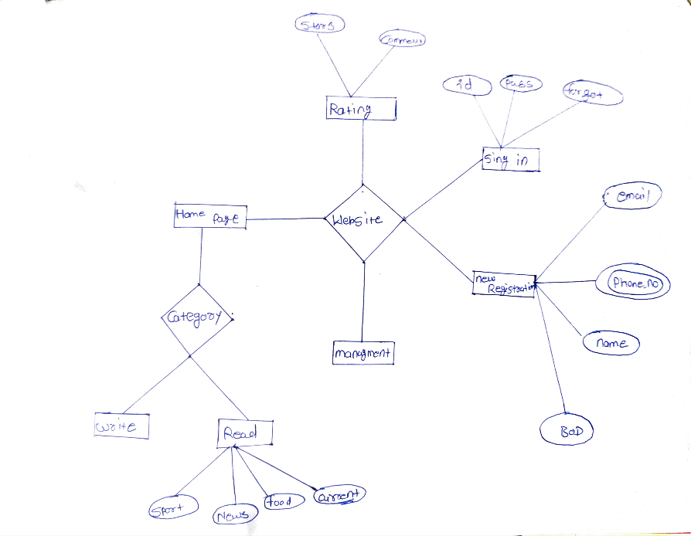
.
ER DIAGRAM
.
PARUL INSTITUTE OF TECHNOLOGY, PARUL UNIVERSITY
6
NAME OF THE INSTITUTE, PARUL UNIVERSITY

Slide 8
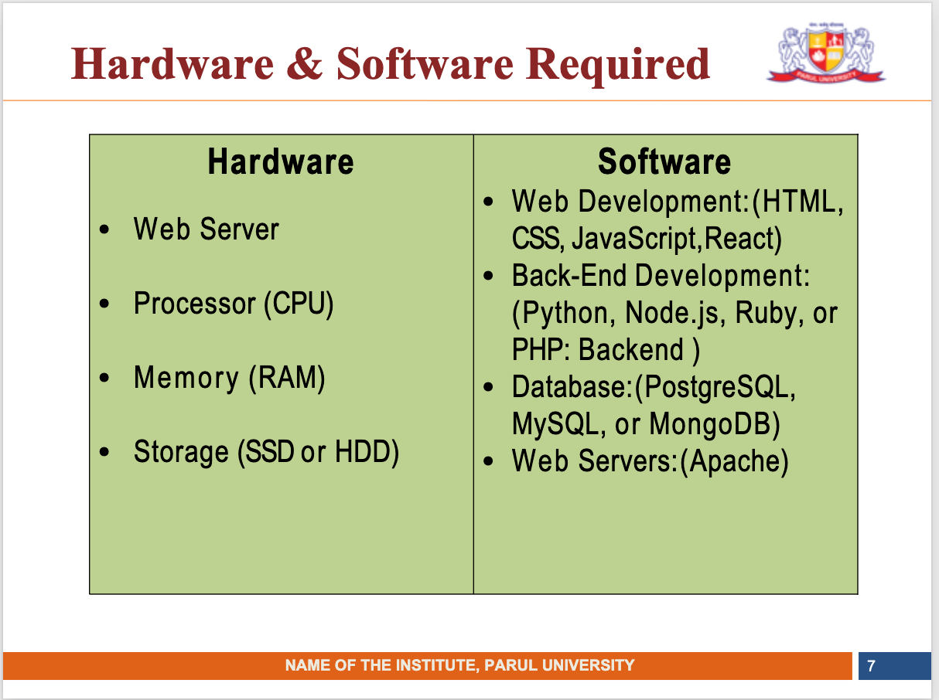

Slide 9
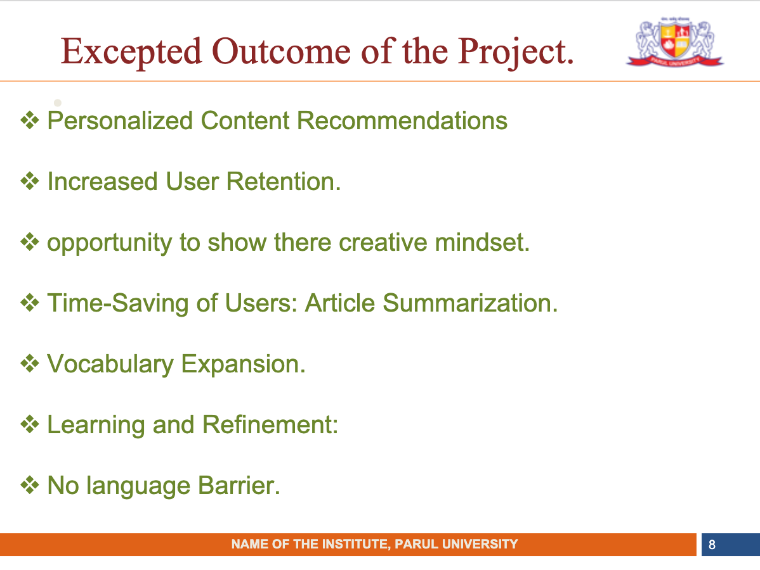

Slide 10
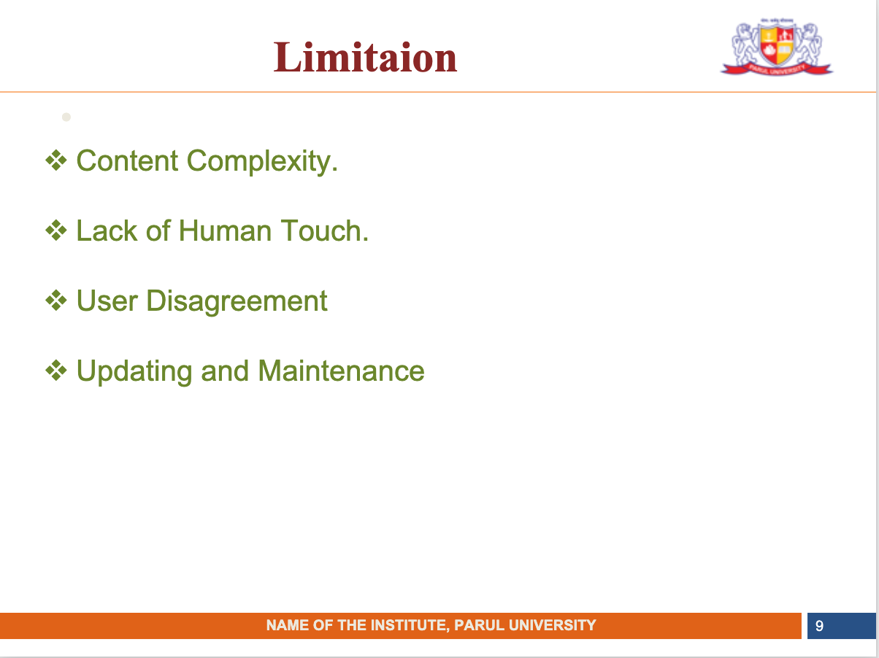

Slide 11
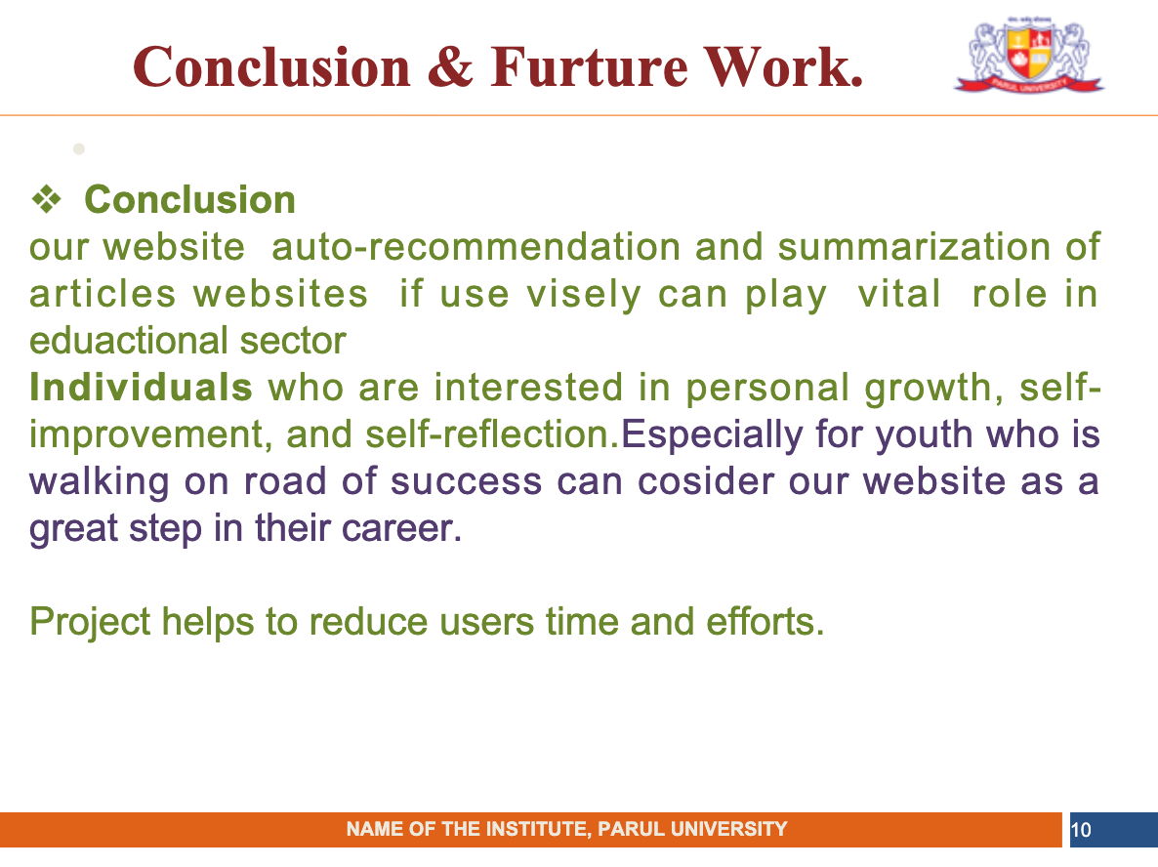

Slide 12
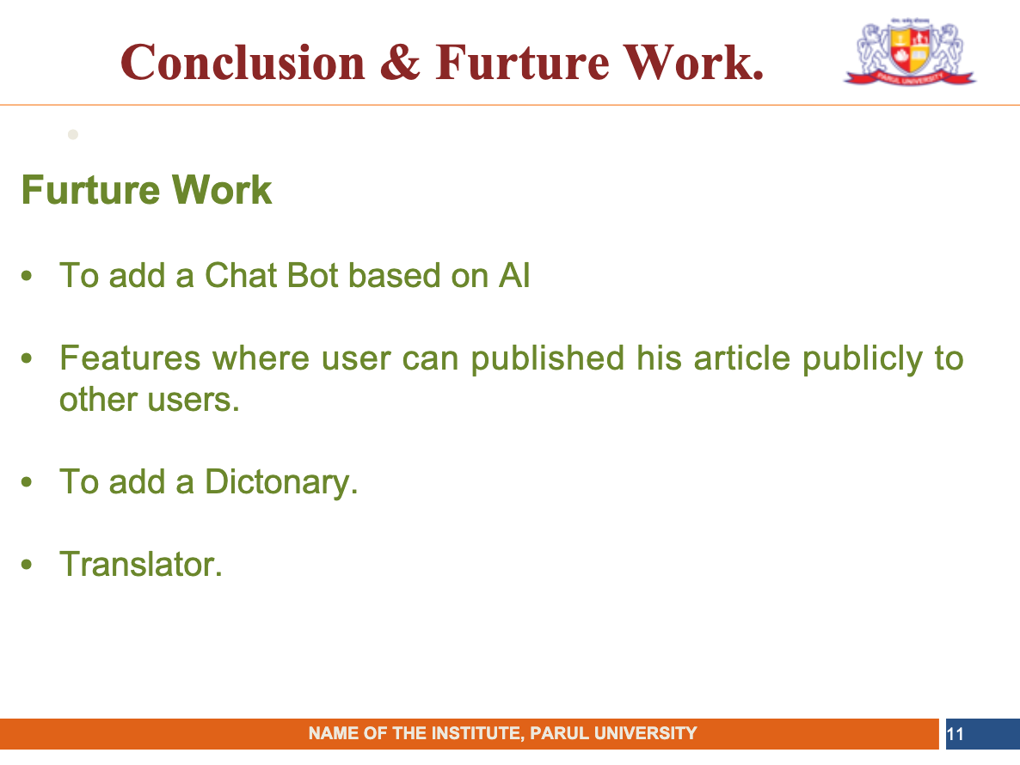

Slide 13
